Slide 1

Data Analysis on Tele Communication
By: Pythonic_Panacea

Slide 2
Content
1
2
3
4
5
Data exploration
Data Analysis
Model 1-SVM
Model 2- LR
Summary

Slide 3

Data Exploration
Telco Customer Churn
Utilizing predictive analysis of customer data enables businesses to develop targeted retention strategies, fostering long-term loyalty and profitability.
https://www.kaggle.com/datasets/blastchar/telco-customer-churn/data

Slide 4
Data Exploration
Every row denotes a customer, and every column includes a description of the client's attributes found in the column metadata.
Clients that have departed in the previous month are listed in the Churn column.
Services that each client has contracted for include phone, multiple lines, internet, online security, online backup, device protection, tech support, and streaming TV and movies.
Details about the customer's account, including the length of time they've been a client, the contract, the payment method, paperless billing, and the monthly and total charges.
Customer demographics include gender, age range, and whether they have dependents and/or partners.

Slide 5
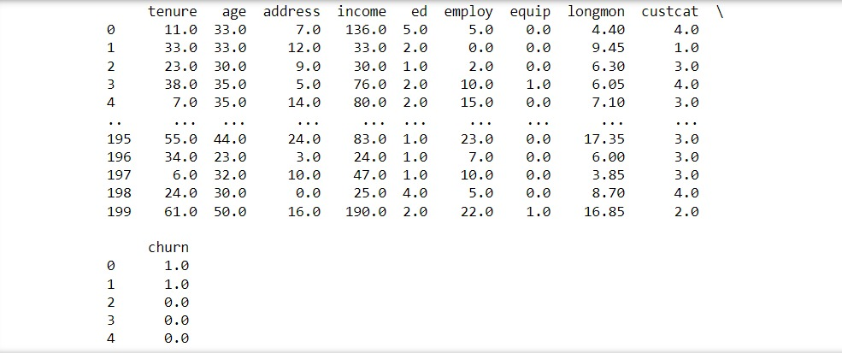
Data Analysis
Raw Dataset

Slide 6
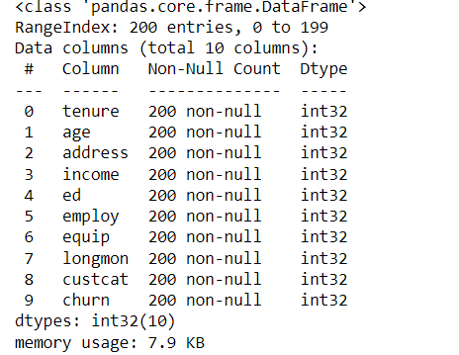
Data Analysis
Dataset after removing unwanted variables.

Slide 7
Data Analysis
Dependent Variables
Independent Variables
churn
tenure
age
income
Ed
Employ
Longmon
custcat

Slide 8
Data Analysis
Splitting the Data
70% of the data is used for training (assigned to X_train and y_train).
30% of the data is used for testing (assigned to X_test and y_test).
Code
X_train, X_test, y_train, y_test = train_test_split(X_var, y_var, test_size = 0.3, random_state = 4)

Slide 9

Model 1 Support Vector Machine

Slide 10

Model 1 SVM
For classification and regression applications, Support Vector Machine (SVM) is an effective supervised machine learning technique. By maximizing the margin between classes in a dataset, it finds the best hyperplane to divide them. SVM works well with high-dimensional data and is especially helpful with complicated datasets that have distinct class margins.

Slide 11
About 80% of the instances in your test dataset had their churn status properly predicted by the Support Vector Machine (SVM) model, according to its accuracy score of 0.8. Put otherwise, of all the examples in the test dataset, the SVM model correctly identified almost 80% of them as belonging to a customer who had churned. Although accuracy might be a helpful indicator, it's important to take other metrics into account as well, particularly if your problem has particular requirements and features. To obtain a more thorough grasp of the model's performance, you could choose to assess additional metrics like accuracy, recall, F1-score, or confusion matrix analysis.
Model 1 SVM

Slide 12
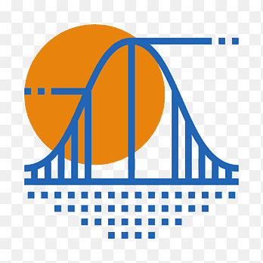
Model 2 Logistic Regression

Slide 13

Model 2 LR
A statistical method called logistic regression is applied in classification problems, in which there are two alternative outcomes for the result variable. Logistic regression is not a regression method, despite its name. It is a classification algorithm. Because of its ease of use, interpretability, and capacity to yield probability for categorization results, it is extensively employed.

Slide 14
Jaccard Similarity Score: This score indicates how similar two sets are to one another. When the Jaccard Similarity Score is 0.2, it means that only 20% of the genuine labels and the projected labels match. The ratio of genuine positive predictions to all positive predictions the model made is known as the precision score. Only 33% of the occurrences that were predicted as positive really were, according to a precision score of 0.33. Log Loss: Log Loss evaluates a classification model's performance when the expected result is a probability value between 0 and 1. It is evident from the rather large log loss of 10.81 that the expected probabilities are not well-calibrated.
Model 2 LR

Slide 15
Classification Report: The classification report gives the support (number of occurrences) and the F1-score, recall, and accuracy for each class (0 and 1). As stated in the report: Class 0 (not churned): F1-score = 0.81, Precision = 0.81, and Recall = 0.81. Class 1 (churned): F1-score = 0.33, Precision = 0.33, and Recall = 0.33. With an overall accuracy of 0.70, the model's predictions are accurate in 70% of cases.
Model 2 LR

Slide 16
Jaccard Similarity Score of our model is 0.2 Precision Score of our model is 0.33 Log Loss of our model is 10.81 precision recall f1-score support 0 0.81 0.81 0.81 31 1 0.33 0.33 0.33 9 Accuracy 0.70 40 Macro avg 0.57 0.57 0.57 40 Weighted avg 0.70 0.70 0.70 40
Model 2 LR

Slide 17
Comparison between models
Model 1 SVM
Model 2 LR
When it comes to churn prediction, the SVM model seems to perform better than the Logistic Regression model (80% vs. 70%) and precision (0.67 vs. 0.33).
On the other hand, the Logistic Regression model appears to have a greater recall (0.33 vs. 0.22) when it comes to churn prediction.
The Log Loss and Jaccard Similarity Score are exclusive to the Logistic Regression model and are not accessible for the SVM model.

Slide 18

Summary
According to the available metrics, the SVM model appears to perform better than the Logistic Regression model in terms of accuracy and precision when it comes to churn prediction, although the Logistic Regression model has a little higher recall. When selecting the best model, it's important to take your issue domain's unique requirements and limitations into account.

Slide 19

Thank you
Feedback!!

